Slide 1
Intelligent Councils These for a full set of slides reporting on the project for the Local Government Association
26th February 2018
Richard Potter, Analytics Cambridge Ltd.
Tel: 07547 132551
Email: richard.potter@analyticscambridge.co.uk

Slide 2
The slides show initial views what helps and is needed for a Council to improve its intelligence.
It forms input into the Local Government Association’s project on “The Intelligent Council: promoting good practice in evidence based decision making”
The slides are structured:
Findings from the survey
How the survey information was gathered
Additional elements of reference set and possible examples

Slide 3
Introduction

Slide 4
Where the information comes from
These slides contain the findings from the interviews carried out
Interviews were written up and sent back to those interviewed
The slides are not based on work carried out by others e.g. NESTA, but clearly there are many points which are similar

Slide 5
The slides are set up showing
Points made by more than a single Council but there is no particular emphasis by number of Councils making the point – varies according to type & experience of Council
Some points are:
issues to be considered, but no single solution seen
some are things that are seen to work by a Council
Each point in only one category, but some could appear in more than one or in an alternative category
The classification used could be re-done with a smaller number or a larger number of these
Some more detailed suggestions e.g. use of iBase, SQL have been omitted

Slide 6
Findings from the survey - which follow - are structured: 1. What is an Intelligent Council? 2. How can an Intelligent Council be recognised? 3. What can be addressed to develop Intelligence?

Slide 7
What is an Intelligent Council?

Slide 8
The reason for developing Intelligence
The ability to look beyond service provision into outcomes
Better informed decision making – not knee jerk reaction which can waste public money
Intelligence allows a Council to get best value for money in what it is already doing. To meet more demand with less
Intelligence can improve a Council’s reputation and opportunity to pilot improvements and work with others
Evidence is needed to bid for additional resources
To be able to operate in a fast changing dynamic world

Slide 9
How can an Intelligent Council be recognised?

Slide 10
Key features in an Intelligent Council 1/4
Importance in developing
Political environment
Capacity for policy
People skills
Use of a sound evidence base for making decisions, but not risk averse
A learning Council would review the past, both successes and failures, and learn from other councils, so can apply this learning to its future decisions and take more considered risks
A clear necessity for an Intelligent Council is an adopted direction of travel. 20/20 Vision. What kind of Borough in 20 yrs.?
Intelligence in analysis – e.g. placing a value on “time” spent providing services for children
Practice which has clear guidelines on technique, levels of standards and how need is shown

Slide 11
Key features in an Intelligent Council 2/4
The ability to carry out scenario planning, answering “what if?” questions
Intelligence includes “horizon scanning”
A key feature can be acceptance to fail if things are tried out. Negative results can be treated as a positive result
Evidence is part of the transparency of decisions made – how and where money is spent
Having trust and confidence in the data – resolving the problem that people may see the data but not believe it
Moving away from a simple reaction to data but into asking questions of it and how it can be used

Slide 12
Key features in an Intelligent Council 3/4
Important is:
Performance indicators giving a sense of what is going on
Activity information showing what is happening. And actively linking this to financial data (i.e. not showing the two separately)
An intelligence function showing the effect of activity
Learning from others and not “reinventing the wheel”
The use of “cost benefit” analysis rather than “cost actual”
The ability in presenting research / data and analysis needs to be made part of management recruitment
The ability to take account of long terms benefits including prevention

Slide 13
Key features in an Intelligent Council 4/4
Having evidence based policy
Moving beyond “let’s always do the same thing with the data”
Intelligence can be seen as:
Cultural barriers
Technical barriers
Statistical barriers
An Intelligent Council would:
be open to learning:
know what it knows
know what it doesn’t know
have open channels - to peers, Universities, informed commentators,
Know what others do
determine what to do and how impact / success will be evaluated
Evidence looks at what happened in the past. Examine issues to see where you are now. Trends may not help for the future

Slide 14
What can be addressed to develop Intelligence?

Slide 15
Identified themes

Slide 16
How do we get there? Key elements
Intelligent Council
Service planning
Data
Communi-cations
Councillors
Partnerships
Resources
Organisation
Culture

Slide 17
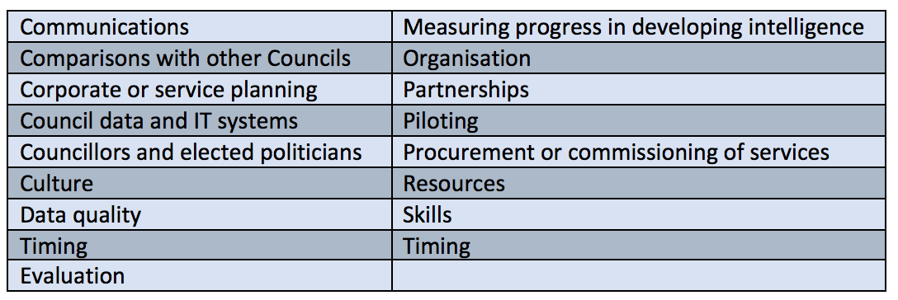
There are different ways of identifying steps in improving intelligence

Slide 18
Communications 1/4
Includes communicating the value of the research
Communications can include setting out risks and benefits as options
In dealing with uncertainty, what are ranges which evidence can show
Examine how to communicate with the public – how can data be shared in a way that meets their needs
Do (research / analysis) roles have sufficiently clear job titles that they can be contacted?
Having openness about methodologies used

Slide 19
Communications 2/4
Analysis such as JSNAs can contain much good data and research. To be most effective the key findings should be able to be interpreted by those making decisions
(!) use of understood language e.g. don’t simply refer to JSNAs
The importance of narrative in presenting data (which can help)
Use of infographics
Performance reports can be asked to be on one side of paper
Vary communications according to the “audience”

Slide 20
Communications 3/4
Regular communication with partners
Can we empower / enable managers to have information at their fingertips?
With managers having access to live information do they have skills / knowledge to interpret it
Holding of open sessions / briefings
Visit local conferences to say what is available e.g. voluntary sector conferences
Putting out open data

Slide 21
Communications 4/4
Variation in how data communicated to same people e.g. members using a ward profile tool or some having information via pdfs
Managers get graphs on their mobile phones
Take those being presented to on a journey to help them understand – its not just presenting statistics
The openness and speed of social media

Slide 22
Comparisons with other Councils
Comparing Local Authorities is more difficult without standard measures
Local Government benchmarking has some value
Note that not everywhere is the same. Data analysis of Partner local authorities needs to take account of the different characteristics e.g. of the population
Benchmarking / peer review can help develop or measure Council Intelligence
Local Government Association Peer Reviews provide independent feedback from an external perspective
Comparison with other Councils can also see if they are doing the same

Slide 23
Corporate / Service Planning
Evidence internal to a Council e.g. sickness levels is important
Managers (of services) need training / skills on the use of and understanding of evidence. Heads of Service need sufficient digital skills to handle numerical data
Need for sufficient financial information for service planning. In a way that service planning doesn’t avoid real issues
Communication with service managers needs to be two way:
Service manager identifies the need for data and asks for research / evidence
Need seen by research team then communicated to service manager
Service manager needs to know what they want so discussion can be on how research would be carried out
Evidence can be used on what to stop spending money on

Slide 24
Council Data and IT Systems
Importance of IT means that this needs to be sufficiently resourced
IT systems may use data for the system’s purpose, but systems where data can be transferred or shared would have advantages
Helps if research / analysis can be considered at an early stage of the purchase of IT systems

Slide 25
Councillors – Elected Politicians
Helps to find a balance between not interested in evidence and too much attention to detail. Helps to keep strategic perspective on what needs to be done & what the evidence shows
Is evidence expected at Committee when business plans are considered?
The use of evidence will be influenced by the political cycle (i.e. how close to the next election)
Consider induction for Councillors help
Members might be more interested in topics where they can see the outcomes e.g.” fly tipping”
Members are connected “locally” and they can have expertise and views on why something happens
Research & analysis can be supported by open sessions with Elected Members

Slide 26
Culture 1/2
Understanding that research takes time, but is needed
Need for research to have independence
The ability to ask “where is the evidence?”
For evidence to stimulate thinking. There may not be one answer but different questions can be considered
A common culture to evidence is at least as important as a written plan
Evidence can show things missing – unmet need

Slide 27
Culture 2/2
Committee reports can have a structure that emphasis the use of evidence
Decision making is not perfect. Exposure to challenge necessary as is acknowledgment of “unknown unknowns”.
Is the work within the organisation’s appetite for risk? (& is analysis capable of moving or testing the boundary)
Use of open data allows residents and businesses to give views – officers and members are not the only ones with these

Slide 28
Data Quality
Data quality can be assessed through audits
The importance of data quality needs to be promoted within service departments
Tracking can vary between services / departments e.g. adult service might have ability to match 90% of records (with NHS), for children’s services this might be much lower
The need to carry out data cleaning

Slide 29
Data Sharing 1/3
This can impact within an organisation as well as between organisations
Linking data sets being considered e.g. housing, adults in social care, looked after children
What IT solutions would be needed for data sharing?
Complex data matching can be needed
Data security important
Data sharing between different data sets could benefit showing those “at risk”

Slide 30
Data Sharing 2/3
A website to present data to the public can contain locked down areas to share more confidential data
Moving to a data warehouse
Establishing “Accountability and Governance” General Data Protection Regulation (GDPR)
With data sharing between organisations a joint structure & management of IT can help

Slide 31
Data Sharing 3/3
Data analysis better from main systems rather than secondary systems
Is there a person who has a watching brief over GDPR / Data protection ? e.g. Chief Information Officer
The value of a single data repository

Slide 32
Evaluation
There can be a lack of rigor in measuring performance
Evaluation can be carried out with the team who carried out the service / project. This means it is not quite independent but the data used can be more relevant
With a pilot project it can be seen that everyone wants it to work, is evaluation possible which says it doesn’t?
Intelligence should follow piloting as projects turn into “business as usual”

Slide 33
Measuring Progress
NESTA Wise Councils Insights from the Cutting Edge has a data maturity model which can be used to assess data maturity – approach to handling data
NESTA framework can be used for for a Council / partnership to rate itself
Intelligence “scores” might vary between departments in a Council
Use of a balanced scorecards e.g.
Service -> Issue | Service 1 | Service 2 | Service 3
Sickness levels
Finance
Etc.

Slide 34
Organisation 1/2
A number of structures can work
Central resources can help
to enable data sets from different parts of organisation to be used together
to set standards
Provide specialised skills e.g. GIS
Virtual teams / networks could bring more flexibility than isolation in departments
Matrix teams can work well (but this needs good management)
Organisational knowledge can be lost in reorganisations

Slide 35
Organisation 2/2
To use of the wealth of data in Councils, with the use of external data, increasing the value of data is helped if there aren’t “silos”
Having the research function central or more widely distributed should be considered. These are options. Data quality might be better in a distributed model
The Intelligence Unit could be placed outside the LA so that management or political independence is more secure
Establishment of “service hubs” rather than complete centralisation

Slide 36
Partnerships 1/3
External partners can include:
Clinical Commissioning Groups
Local Authorities - Districts and County Councils
Local Authorities - Neighbouring
Fire Service
Local Enterprise Partnerships
Police
Universities
Voluntary Sector

Slide 37
Partnerships 2/3
The importance of IT systems being able to share data is something to consider when exploring partnership with another organisation
Different options could be tested in different LAs e.g. in Combined Authority areas, across LEP boundaries
Issues can be tackled by agencies which have different boundaries
Partnership can be on policy and delivery and the evidence used for this. This can engage relevant bodies
Partnerships can avoid duplication of work (i.e. between County Councils and Districts)

Slide 38
Partnerships 3/3
Interaction and relationships with Government Departments, Office for National Statistics etc.
Feed back the picture to national bodies e.g. Bank of England, Government
Can skills needed be made available in the work of small organisations e.g. voluntary sector?
Needs for agreement on definitions and standards e.g. what is a missed bin or customer complaint?
Teams (e.g. a performance & improvement team) can work across Councils - which shares learning
Work with other organisations e.g. LEPs can provide a richer source of data and approaches

Slide 39
Piloting
Test or pilot changes at a small scale
Piloting of different options can be done simultaneously
Transferability and scalability are key issues on piloting

Slide 40
Procurement / Commissioning of Council Services
Analysis of supplier data needs to be possible to manage 3rd party services effectively
Those who commission analysis e.g. write specifications for a survey, need to have skills so the analysis requirements feed through
Intelligence is more than simply holding people to contract, it should be knowing the needs of service users
Contracts can be simple for services (i.e. allow flexibility) but researchers need to be able to see if the contract works

Slide 41
Resources 1/2
Use of technology for regular or routine analysis. This reduces demand on analysis staff need and they can become more forward looking or specialised
Combining some research functions with another Council or other organisation can increase capacity:
academic,
private company
voluntary sector)
Research needs the capacity to take on new work, space needed “above the day job”
Use of “community talent” – how to make this work. E.g. through “hackathons”
Movement away from handling “ad hoc” / simple request for data – this can be done through sites or dashboards
There are sources of free online training

Slide 42
Resources 2/2
Having room for innovation
Make information available – “here is the information you can use”
Students work with a Council and present their dissertations
Civic ownership of open data has value in cutting deals with other organisations

Slide 43
Skills
Intelligence improved by the skills including mathematics & statistics
Data interpretation
Knowledge of data and services
Across the organisation different skills are needed for analysis than “simply” the use of management information
Within a research function staff need to be either “good with people” or know enough about analysis to manage the processes
Employment of data scientists
Communication skills

Slide 44
Timing
Intelligence is analysis not left too late
Need to be engaged in the early stages of business planning
Plan evaluation before a policies are made, this allows choice of performance measures
Need to have systems in place that can take account of committee meetings so the timing of these does not delay work

Slide 45
~ end ~

Slide 46
References and examples

Slide 47
References
reference file with c. 100 references, categorized & links to sources
those recommended by interviewees and also through searches

Slide 48
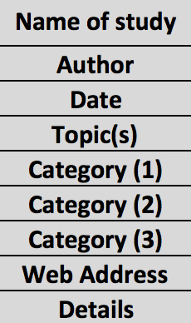
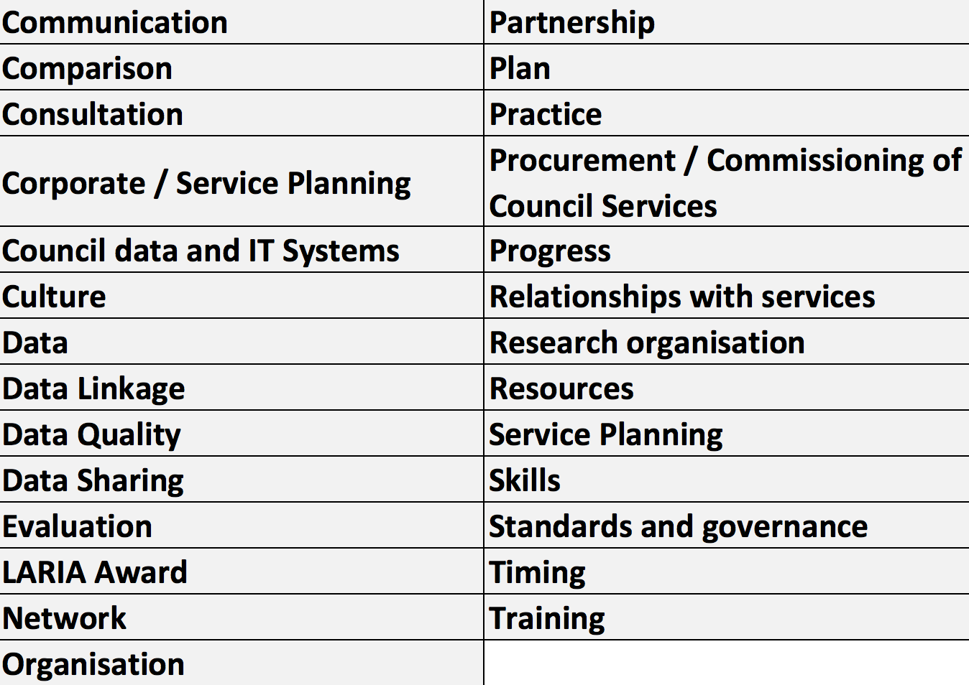
References information
Categories

Slide 49
Examples: LARIA award winners 2015 & 2017
Oxfordshire County Council has developed new Data Stories following a consultation with local data users. Data Stories provide data on a topic as a sequence of interactive infographics. This enables novice data users to access the data on a topic in a structured, simple-to-use and understand way. Unlike conventional static infographics, Data Stories let the user customise the data contained in the infographic for their individual needs. Presenting data this way makes is more accessible for the average user, who struggles with statistics, and also makes it possible to access data on mobile devices which may not handle spreadsheets well.

Slide 50
~ end ~

Slide 51
2. Summary of those who gave their views in the survey

Slide 52
How was the work carried out?
Views were sought from people working in a range of organisations on what they thought an intelligent council would like:
what were key issues to help a council become intelligent
what were approaches which had worked for them
problems they were trying to tackle
sources of information or knowledge which helped
anything which didn’t work
c. 50 interviews carried out
Three quarters held by phone and one quarter through interviews. Group workshop in Manchester
Information from discussions held on Knowledge Hub
The results from each interview confidential giving them the opportunity to be more open
Those interviewed were asked to draw from their experience in different roles and organisations
Posts on Knowledge Hub and LinkedIn. Knowledge Hub thread formed discussion between 10 contributors with 36 posts and 435 views.

Slide 53
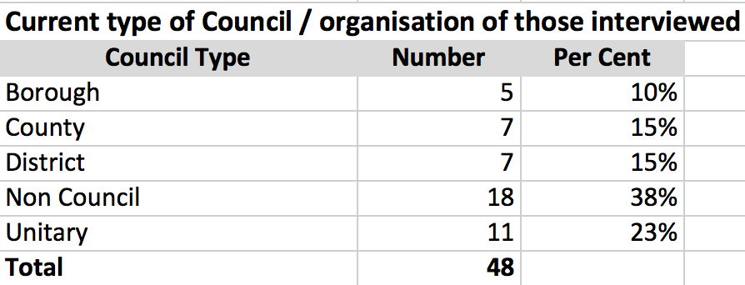
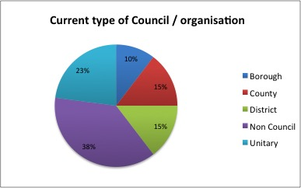
Current type of Council / organisation of those interviewed
Non Council e.g.
National Audit Office
Royal Society for Statistics
Royal Town Planning Institute

Slide 54
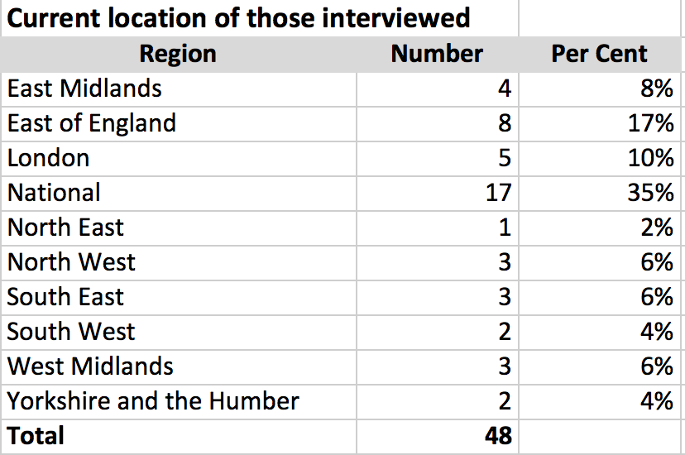
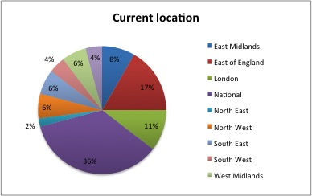
Current location of those interviewed
Included small number from Scotland and Wales

Slide 55
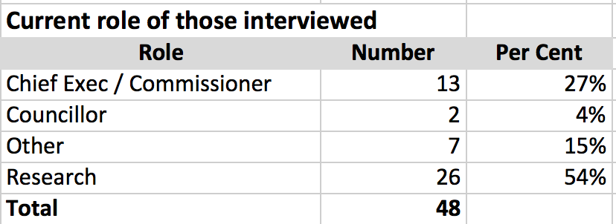
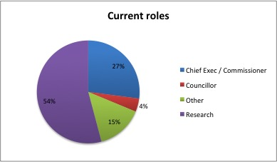
Roles of those Interviewed
Commissioner e.g.
Assistant Director of Health Integration
Corporate Director of People
Policy & Programme Manager

Slide 56
~ end ~

