Slide 1
LGA Advanced and Predictive Analytics Network Webinar 12 - 5th December Public Sector Equality Duty & Artificial Intelligence – EHRC Guidance & Monitoring Project
Max Edelstyn
and
Claire Lesko
Notes:
[put presentation into slide mode]
So good morning to everyone. I am Max E and today I’ll be jointly presenting with my colleague Claire Lesko.
The work that Claire and I do is mainly focused on public bodies in England, including the UK Government. The majority of our work is focused on promoting compliance with the Public Sector Equality Duty – the P-S-E-D.
Today I am going to talk a bit about our work at the Commission, then I will introduce the PSED and our guidance on the PSED and AI.
Claire will then talk to you about some work that we are doing to look at how a selection of local authorities are meeting the requirements of the PSED whilst using AI. [Next Slide]

Slide 2
The Role of the Commission
Established by the Equality Act 2006
We have a range of powers and duties. These include:
Providing advice and guidance;
Undertaking research and publishing State of the Nation reports
Undertaking Investigation and Inquiries
Agreements and Action Plans
Legal cases
PSED Monitoring and enforcement

Slide 3
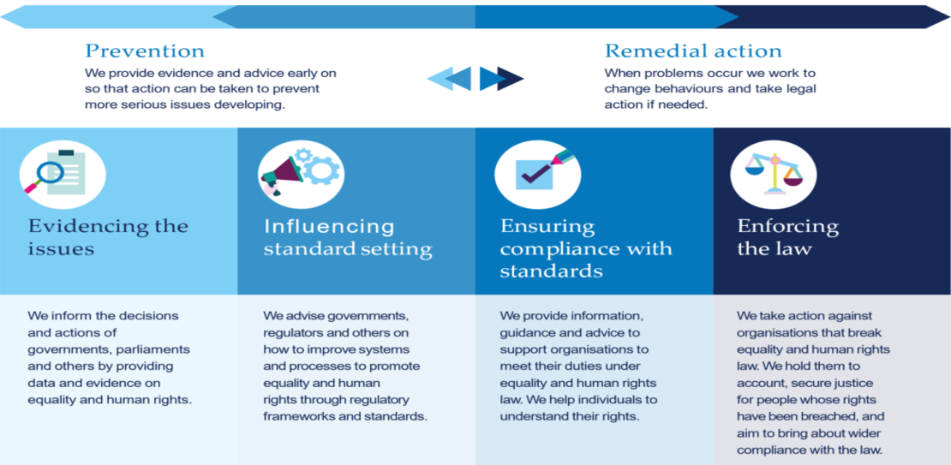
Our Regulatory Model
We work through a regulatory model that sets out how we use our statutory powers to fulfil our remit to improve equality and human rights and enforce compliance with the law. This model helps us to plan our work, and identify and measure the impact we achieve.

Slide 4
What is the Public Sector Equality Duty
Requires public bodies to think about equality across their work
Designed to deliver transformational change
Organisations that think about the needs of all service users deliver better services
Includes any services that are commissioned
Transparency and accountability
South Wales Police case
Notes:
.

Slide 5
EHRC Guidance on AI and the PSED
The AI Guidance is quite short and hopefully very accessible.
Section one considers some of the benefits of AI and also the risks, including how the use of AI may lead to discrimination and/or deepen inequality.
Section two provides an introduction to the PSED and describe the general and specific duties.
It includes a few case studies to illustrate how AI can be relevant to equality and the services public bodies provide.

Slide 6
EHRC Guidance on AI and the PSED (2)
Section three of the guidance provides a 10 step checklist for public bodies:
Step 1 – Does your organisation use AI?
Step 2 – Collect equality evidence; talk to staff/service users.
Step 3 - Consider how the AI might be relevant to equality.
Step 4 – Consider each of the three aims and the scope for positive benefits.
Step 5 – Do you need to stop or change how your AI works?

Slide 7
EHRC Guidance on AI and the PSED (3)
Section three of the guidance (steps 6 – 10):
Step 6 – Use the assessments to inform your decision making.
Step 7 – Keep a record of your decision making.
Step 8 - Publish the results, be transparent.
Step 9 – Train staff so they understand their responsibilities.
Step 10 – Continue to monitor the actual impact of the AI.

Slide 8
PSED DEEP-DIVE - AI & Local Authorities
Aim – Assess how public bodies in England and Scotland are complying with the Public Sector Equality duty when commissioning & using AI.
Purpose - Identify good practice examples to share & help the public sector improve the way it thinks about equality in this space.
Scope – Up to 30 organisations across England & Scotland – focus on local authorities in England.
Timescale – Just started & initial findings anticipated by the end of March.

Slide 9
PSED DEEP-DIVE – Project scoping
Considering evidence - e.g. reports published by Shared Intelligence, Big Brother Watch, the Oxford Internet Institute or the Data Justice Lab.
Consultation with AI experts - e.g. Tim @ LGA, A. Turing, Oxford Internet Institute, Ada Lovelace, Data Justice Lab, CDEI, CDDO, Office for AI.
Need for a general definition & focus on specific techs with illustrative examples where possible.

Slide 10
PSED DEEP-DIVE – What is AI?

Slide 11
PSED DEEP-DIVE – AI definition in the context of this project
General definition
Science and practice of using algorithms and computing technologies to:
identify patterns in large volumes of data in an autonomous way and to learn to answer questions or deal with problems
support decision-making or the delivery of services and information.
Specific techs
Predictive analytical tools
Remote monitoring tools
Commodity AI tools

Slide 12
PSED DEEP-DIVE - AI & Local Authorities
Key areas of interest
Equality in procurement processes
Equality considerations in decision-making
Monitoring of actual impact of using specific AI tools
Training on PSED
Transparency & accountability

Slide 13
PSED DEEP-DIVE - AI & Local Authorities
Are you interested in sharing your approach with us?
Would you like to work with us to improve the way you think about equality when commissioning or using AI?
If so, email us asap at PSEDMonitoring@equalityhumanrights.com

Slide 14
Thank you

