Slide 1
Practical Tips on Records of Processing Activities and Data Protection Impact Assessments
Information Governance Team
Lauri Almond
Information Governance Manager

Slide 2
Content
Scene setting
Records of Processing Activities
Information Asset Registers
Data Lifecycle Mapping
Lessons learned
Data Protection Impact Assessments

Slide 3
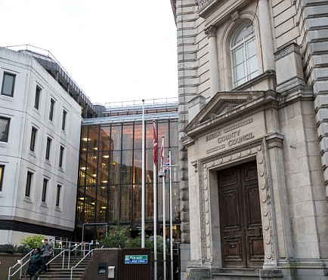
Some scene setting
Essex County Council is a large Local Authority with 10,000 staff working from 123 different sites across the county. In compiling our 1st Records of Processing Activities Database (ROPA) we listed:
3310 Information Assets
3750 Data Flows
Information Asset Owners and Managers
We are now on our 3rd iteration of Information Mapping (and our 3rd database) to refresh the data, with many more flows being identified throughout the journey.

Slide 4
Some scene setting
Essex County Council is a large Local Authority serving 1.75 million citizens and working from 123 different sites across the county. In compiling our 1st Records of Processing Activities Database (ROPA) we listed:
3310 Information Assets
3750 Data Flows
Information Asset Owners and Managers
We are now on our 3rd iteration of Information Mapping (and our 3rd database) to refresh the data, with many more flows being identified throughout the journey.

Slide 5
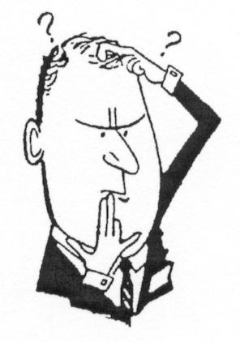
Where to start?
You have to know what you already have in terms of personal data, and what you are doing with it, before you can start implementing GDPR elements. This is best achieved by:
Create or review your Information Asset Register, ensuring its completeness and accuracy

Slide 6
Information Asset Registers
Essential Data to compile
Unique ID
Asset Format (system, paper record, digital record etc.)
Asset Name
Asset Description
Asset Owner
Asset Classification
Applicable Retention Period
Asset Status (active, inactive etc.)
Date Discontinued
Additional/optional data to add value
Business Area
Team Name
Alternative Asset Names
Asset Manager
Asset Location, e.g. which Systems (Apps/Storage)
Third Party Access
Risk rating
Business Continuity contacts
Hosting arrangements
Hosting Location

Slide 7
Where Next?
You’ll need to know where information is coming from and going to. Both in terms of from who to who but also from where in the world to where in the world.
You will therefore need to map ALL of your Personal Data Flows (in/out/static)
Pull this data together, either creating a relational database, or in smaller settings, a spreadsheet

Slide 8
Data Lifecycle Mapping
Essential Data to compile
Unique Flow ID
Name of Flow
Asset ID
Inbound/Outbound/Static
Classification
Internal/External flow/ or both
Article 6 Condition (Sch 2)
Article 9 Condition (Sch 3)
Volume (Bulk/Ad hoc)
Frequency (Daily/Monthly/Quarterly/Annually/ As & When)
Recipients (Internal/external/who/where/outside EEA)
Transfer Method (Auto/Manual/Email/Fax/Post/SMS/Social Media)
Controls (Encryption/PIA/Privacy Notices/ISP/Contract)
Security Incident References
Risk Rating
Review status
Data Controller/Processor
Additional/optional data to add value
Hyperlink to relevant contract/ISP/MoU (inc. start and end dates)
Hyperlink to relevant privacy notice
Hyperlink to PIAs
Adequacy Decisions/BCRules
Article 49 condition (outside EEA)
DPA 18 Schedule (Employment and Crime Data)
Additional Consent data (internal/3rd Party/Marketing)
PCI compliance

Slide 9
And finally…………………
Add in the remaining elements required under Article 30 to produce your full Records of Processing Activity, e.g.
Details of the Data Controller and DPO
Purpose of processing
Categories of Data, Recipients and subjects

Slide 10
Ta dah!
Once you have successfully created your ROPA, you will have clear sight of what you have and what you are doing with it, and can then address the gaps effectively
Hazard Warning!!
Having taken the pain of creating your ROPA, remember it is a living thing and requires constant attention – updates, reviews etc.

Slide 11
Our lessons learned
Get Asset register right first
Senior Leader buy-in essential
Clear understanding of the definitions of assets, flows etc.
Assign & train Asset Owners and Managers
Face to face data gathering
Define a process/system for carrying out the work so there is a consistent approach
You need an iterative approach to collecting the data and improving the process
Consider bringing in additional data to centralise Information Governance recordings, e.g. security incidents, staff training schedules, Teams, Policies, legislation list, Business Continuity, DPO Complaints, Supplier and Third Parties list, list of systems/apps, retention schedule, Countries list (adequacy, EEA, EU).

Slide 12
What issues have you experienced in building your ROPA?

Slide 13
Data Protection Impact Assessments

Slide 14
Requirements
DPIA needed when considering new technologies or processes where there is a high risk to the privacy of individuals, and in particular where:
Systematic and extensive evaluation of personal data, including profiling where decisions are made based on that data
Large scale processing of special categories of data relating and any processing of criminal data
Systematic monitoring of a publicly accessible area
Your Data Protection Officer will need to approve DPIAs
The DPIA must contain as a minimum:
A systematic description of the proposed processing and its purpose
An assessment of the necessity and proportionality in relation to the purpose
An assessment of the risks to data subjects
The measures required to address the risks, including safeguards, security measures and mechanisms to ensure adequate protection and demonstrate compliance

Slide 15
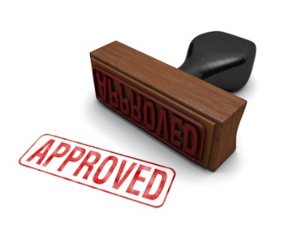
Prior Consultation
Required where processing would result in a ‘high risk’ in the absence of measures taken to mitigate the risk by the Data Controller – in English that means where there is a high level of residual risk once you have applied all mitigations available to you.
Where the ICO consider the intended processing is non-compliant they will provide written advice to the controller within 8 weeks. The period may be extended by 6 weeks for complex processing. Where the ICO are waiting for further information from the data controller the time is suspended.
When consulting the ICO, the data controller must provide:
Where applicable the responsibilities of the data controller, joint controllers and processors
The purpose and means of the intended processing
The measures and safeguards provided to protect the rights of data subjects
Contact details of the Data Protection Officer (DPO)
The DPIA
Any other information requested by the ICO

Slide 16
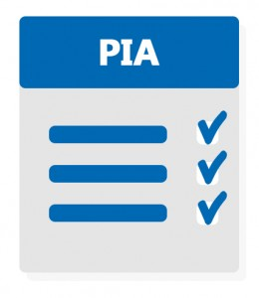
Typical DPIA headings
The Proposal
Title of Project/Process
Business Owner
DPO
DPIA Risk Assessment (High Risk – Y/N)
The Data
Personal Data - Field Names/Format/Classification
Special Categories of Data - Field Names/Format/Classification
Categories of Data Subject
Data risk profile – Minor/Medium/Major/Critical
The Principles
Legal Basis for processing (PD & SCoD)
Other applicable legislative gateways
Consent
Rights – informed/access/rectification/erasure/restriction/data portability/object/auto decision making/profiling
Data Subject consultation
Purpose

Slide 17
Typical DPIA headings – Contd.
The Principles – contd.
Data minimisation
Accuracy
Retention
Security
Tender process
Contractual controls
Contract Term
Supplier(s) & Accreditation
Training
Organisational Policies
Technical Controls
Access
Security at rest
Security in transit
Transfers outside of EEA

Slide 18
Typical DPIA headings – Contd.
Risk Management (risks, controls, mitigations, ratings)
Attachments
Privacy Notice
Consent Form
Business Case
PID
Specification
High and low level design documents, network diagrams
Procurement evaluations, contracts, agreements
Reviews
Approvals
Requirements
Design & Test
SIRO
DPO
ICO (prior consultations only)

Slide 19
Our lessons Learned
Difference between PIA and DPIA?? None.
Keep language plain and clear
Ensure staff understand their responsibilities…Invest well in training & awareness
Common trap business areas fall into is stating that they ‘do not see the data’ therefore they are not the Data Controller……
It is easier if an IG professional writes the DPIA based on information provided by the business area, rather than asking the business area to complete the form
Make sure your DPIA process is easily accessible to your staff
DPIAs need a documented review process to guard against purpose creep post implementation
Need to firmly anchor your DPIA process in your finance, procurement, contract management, IT and project management processes to ensure the process is not circumnavigated

Slide 21
And finally ………………

