Slide 1


Adult Social Care
through key statistics
To see the data used in this infographic click here
We all want to live in the place we call home, with the people and things we love, in communities where we look out for one another, doing things that matter to us. We might need some support with this if we have a disability or health condition.
This is the role of social care.
Councils must provide or arrange services that …
The Care Act (2014)
introduced a national CRITERIA to assess eligibility for social care and to ensure wellbeing and independence
Eligible needs are:
a physical or mental impairment or illness
PREVENT
people developing needs for care and support
unable to achieve 2 or more of the outcomes specified
DELAY or REDUCE the need for ongoing care
and support.
there is significant impact on the adult’s wellbeing
Getting dressed
Support may be funded fully, jointly or partly by:
- the council
- the NHS
- the individual requesting support
Getting washed
Going to the toilet
An adult or their carer need support with…
Making
use of facilities/ services
A financial assessment is carried out to determine who will pay for the care and support
Food preparation and
eating
Safety
in the home
Care from family or friends
Pay for care privately
Apply for help from the council
© 2026 Local Government Association. All icons made by Freepik from www.flaticon.com

Slide 2





Adult Social Care
Understanding need
There are
46.4 million
adults in England
2 million NEW requests for adult social care in 2024/25
888,755
adults receiving long-term support in 2024/25
238,790
adults in total receiving short-term care to maximise independence
35.5 million (76%)
age 18-64
11.0 million (24%)
age 65+
66%
65%
89%
were people aged 65+ years
The population is ageing. Forecasts predict the proportion aged 85+ years will increase from 2.5% to 3.3% over 25 years. We expect this would lead to an increased demand for adult social care.
Healthy life expectancy
61.5 years
61.9 years
Full life expectancy
79.1 years
83.1 years
4.7 million (8.3%)
people provide
unpaid care at home
MALES
FEMALES
Equivalent to 8.3% of the population
4.3% provide up to 20 hours of care per week
1.8% provide 20-49 hours per week
2.6% provide 50+ hours
People are living longer with long-term health conditions and healthy life expectancy has decreased by 9.3 months for males and 14.0 months for females in the last decade.
17.3%
(9.8 million)
have a long-term condition lasting or expected to last more than 12 months
18.2%
of people aged 65+ report a long-term health problem or disability
184,745 new service users who had short-term support to maximise independence
5.2%
(2.9 million)
of people reported bad or very bad
health
77.1%
resulted in no ongoing support needs or support of a lower level
© 2026 Local Government Association. All icons made by Freepik from www.flaticon.com

Slide 3
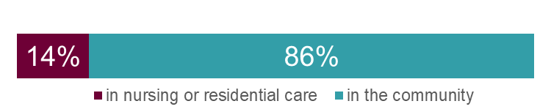
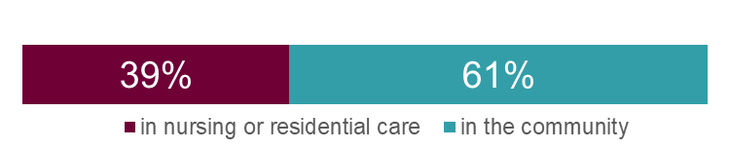
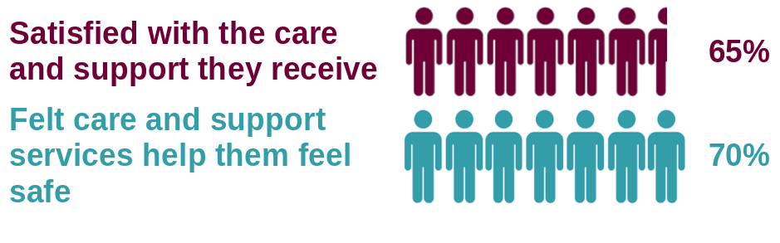
Adult Social Care
People
People accessing long-term care
At the centre of adult social care are the individuals being supported to live as independently as possible in a safe environment that enhances their wellbeing.
Overall, around 1.9% of the adult population are receiving long-term care, with 70% of those being cared for in the community.
0.9%
of the population age 18-64 (approximately 310,000 people) are accessing long-term support from their local authority
5.2%
of the population age 65+ (approximately 580,000 people) are accessing long-term support from their local authority
The needs of people needing social care support are becoming more complex
The majority of people continue to be cared for in their homes, many by family and friends with some support from their council
Still, around 3 out of 4 adults age 65+ will face care costs in their lifetime
Satisfaction levels and feelings of safety have remained consistent over time, despite the additional pressures services are facing.
Satisfaction levels and feelings of safety have remained consistent over time, despite the additional pressures services are facing.
© 2026 Local Government Association. All icons made by Freepik from www.flaticon.com

Slide 4

Adult Social Care
Expenditure 2024/25
Equivalent to
£633
per adult in the population
Gross current expenditure on adult social care was
£29.4 billion
in 2024/25
8.6% increase
from 2023/24
34%
of councils’
overall spend
(Net Revenue Expenditure)
Long and short-term care costs
£24.6 billion was spent on long and short-term care, an increase of 9.9% on the previous year - with 52% spent on older adults.
spent on younger adults (age 18-64) was for people with a learning disability
spent on older adults (age 65+) was for people with physical support needs
£23.6 billion
was spent on
long-term care
(96% of care costs)
£1.1 billion
was spent on
short-term care
(4% of care costs)
9.9 %
66%
£11.8 billion spent on
age 18-64
£12.8 billion spent on
age 65+
66%
Average spend per person per year
accessing adult social care
£37,692 £22,258
Average spend per person per year
in the population
Age 18-64
£333 £1,168
Age 65+
The average spend per person accessing adult social care is higher for younger adults. However, due to the higher numbers of people accessing adult social care in the older age group, and England’s age distribution, the spend per person in the population is 3.5 times higher for older adults than for those aged 18-64.
© 2026 Local Government Association. All icons made by Freepik from www.flaticon.com

Slide 5

Adult Social Care
Workforce
Adult social care employees in the independent and local authority sectors
Adult social care contributed an estimated
£77.8 billion
to the economy in England
in 2023/24
1.33 million
employees in 2024/25
1.465 million filled posts
+
97,000 vacancies
40%
part-time
74% direct care
1,080,000 posts in a direct care role
8% managerial
123,000 posts in a managerial role
78%
female
38%
from an ethnic minority background
4% regulated professionals
Registered nurses, Social workers, Occupational therapists
14% other roles
Administrators
HR, Finance and
Training roles
31%
non-British
nationality
average age
44 years
All sectors,
all services
In 2024/25, of the 1.465 million filled posts across the local authority and independent sectors, 1.345 million (92%) were in the independent sector and 120,000 (8%) were in the local authority sector. There were an additional 131,000 filled posts for people employed by direct payment recipients.
Unpaid carer
support is estimated
to be worth
£152 billion
per year
© 2026 Local Government Association. All icons made by Freepik from www.flaticon.com

